Slide 1
Business Intelligence
Customer Intelligence &
Behavioral Analytics
Dashboard
Turning Customer Behavior Data into Strategic Business Decisions
Prepared by Meghana M
~4K
Power BI
SQL
DAX
Python
Customer Records Analyzed

Slide 2
01 / Project Overview
Project Overview
Core Objective
Tools & Technologies
Analyze customer purchasing behavior to uncover actionable insights that improve retention, increase average order value (AOV), and reduce over-reliance on discount-driven sales.
Power BI
SQL
Dashboard
Data Query
Analysis Focus Areas
DAX
Python
Revenue contribution by customer segments
Analytics
EDA
RFM-based behavioral segmentation
Purchase frequency vs. spend patterns
Core Business Question
Subscription impact on repeat behavior
Discount influence on customer satisfaction
"How can customer behavior insights be used to improve retention, increase customer value, and support sustainable revenue growth?"

Slide 3
02 / Dataset Summary
Dataset Overview
~4,000
15+
37 Values
Data Constraints
Customer Records
Columns
Missing Data
No transaction-level timestamps (recency approximated)
Feature Categories
CLV calculated as a proxy metric
No marketing channel data for attribution
Demographics
Behavioral
Age, Gender
Purchase Frequency, Previous Purchases
No geographic or income segmentation
Financial
Engagement
AOV, CLV Proxy
Subscription Status
Satisfaction
Promotional
Data Quality
Review Rating
Discount Applied
Completeness
High
Consistency
Verified

Slide 4
03 / Data Preparation
Data Preparation & Modeling
01
Data Cleaning
02
Feature Engineering
03
Analytical Modeling
Standardized column formats across all data sources
RFM Segments: Champions, Loyal, Occasional, At Risk
Grouped customers by RFM logic for targeted analysis
Verified categorical consistency for accurate grouping
CLV Proxy: Derived metric for customer lifetime value estimation
Calculated revenue and AOV per segment
Aggregated behavioral metrics for dashboard KPIs
Checked for missing values and handled appropriately
Frequency Levels: Categorized purchase frequency for analysis
Output
Business-ready segmentation for strategic decisions
Output
Output
Clean, structured dataset ready for analysis
Enhanced features enabling behavioral segmentation
Key Achievement: This modeling enabled business-ready segmentation instead of simple descriptive reporting, providing actionable customer intelligence.

Slide 5
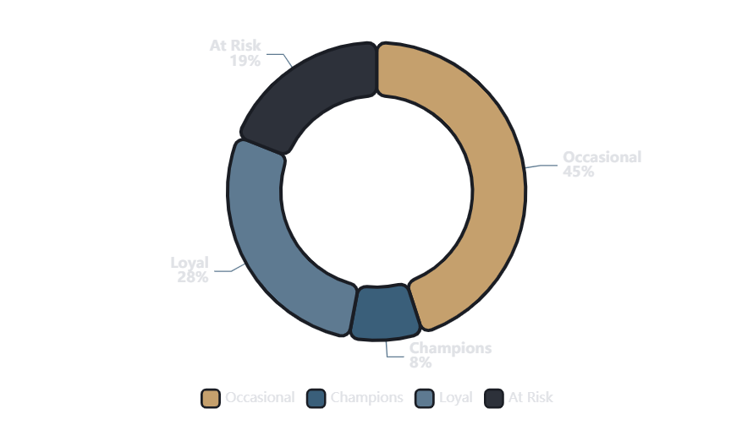
04 / Behavioral Analysis
Revenue Contribution by RFM Segment
Revenue Distribution Across Customer Segments
Occasional
Total revenue contribution by RFM segment
Highest Revenue
Contribute the highest total revenue despite lower individual AOV
Champions
Highest AOV
Show highest AOV (~₹100) but represent very small customer share
Loyal & At-Risk
Moderate Revenue
Contribute moderate revenue levels with growth potential
Critical Insight
Revenue is currently volume-driven rather than loyalty-driven. This indicates a strategic opportunity to shift toward value-based customer cultivation.

Slide 6
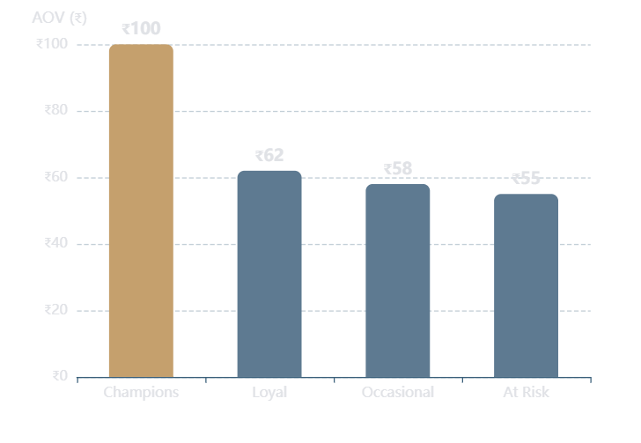
05 / Behavioral Analysis
Average Order Value by Segment
AOV Comparison Across RFM Segments
Key Findings
Average order value in Indian Rupees (₹)
Champions Lead
₹100
AOV
Champions have the highest AOV at approximately ₹100, significantly outperforming other segments
~₹60
Other Segments
Avg AOV
Other segments show lower and relatively similar AOV levels, indicating standardization
Strategic Insight
Expanding the Champion segment could significantly increase profitability. The 67% AOV premium suggests strong potential for premium customer cultivation strategies.
67%
8%
AOV Premium
Champion Share

Slide 7
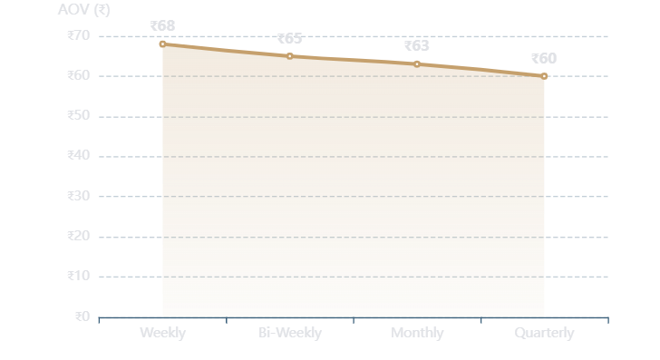
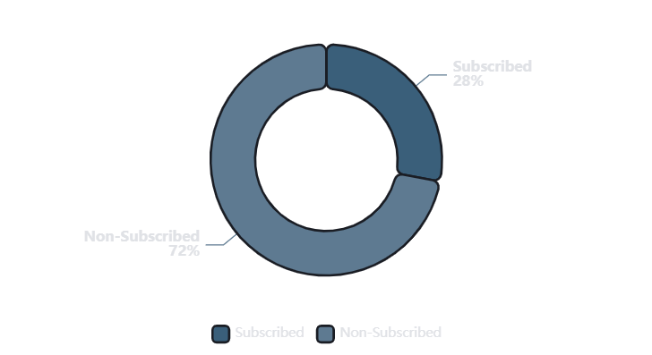
06 / Behavioral Analysis
Purchase Frequency & Subscription Behavior
Purchase Frequency vs Customer Spend
Subscription Status Distribution
AOV stability across frequency levels
Customer engagement through subscriptions
Insight: Weekly buyers do not show significantly higher AOV. Spend levels remain relatively stable across frequency levels.
Insight: Subscribed users show stronger repeat behavior indicators. Majority of customers are non-subscribers.
Critical Finding
Growth Opportunity
Increased frequency does not automatically increase order value
Subscription adoption remains a significant growth opportunity

Slide 8
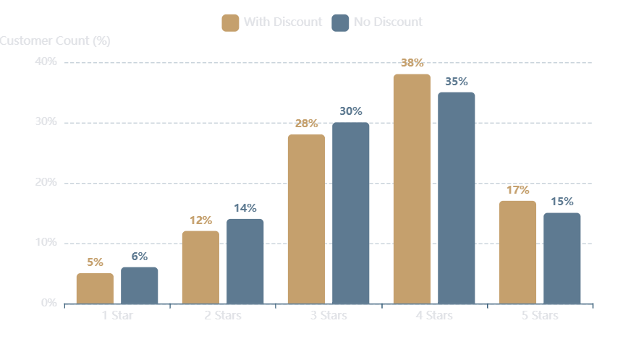
07 / Behavioral Analysis
Discount Impact on Customer Satisfaction
Review Rating: Discount vs No Discount
Analysis Results
Customer satisfaction comparison by discount application
With Discount
3.8
Discount Applied
Avg Rating
No Discount
3.7
Full Price
Avg Rating
Critical Insight
Discounts do not significantly influence customer satisfaction. The 0.1 rating difference challenges the assumption that price reductions drive positive customer perception.
0.1
2.7%
Rating Difference
Impact Margin

Slide 9
08 / Dashboard Design
Power BI Dashboard Design
Dashboard Architecture
Key Design Features
01
Overview Page
High-level KPIs and executive summary metrics
Interactive Navigation
Tooltip Exploration
Seamless page transitions
Detailed data on hover
02
Customer Insights
Detailed behavioral patterns and demographics
KPI Summary Cards
Visual Hierarchy
03
RFM Analysis
Quick executive review
Consistent formatting
Segment performance and customer lifecycle
04
Business Insights
Dashboard Benefits
Strategic recommendations and action items
Real-time data visualization
Drill-down capabilities
Design Philosophy
Cross-filtering between visuals
Create a decision-support dashboard rather than a static academic report, enabling real-time business intelligence.
Mobile-responsive design
Export and sharing options

Slide 10
09 / Strategic Outcomes
Key Insights & Recommendations
5 Key Business Insights
5 Actionable Recommendations
1
Revenue is primarily driven by Occasional Customers - the largest segment by volume
Convert Occasional Customers
Introduce light loyalty incentives to increase purchase frequency
2
Champions deliver highest AOV but form a small customer base (8%)
Expand Champion Segment
Replicate high-AOV traits through premium offerings
3
Frequency does not strongly increase order value - AOV remains stable
Implement Smart Bundling
Encourage higher basket value instead of repeat purchases
4
Discounts have minimal impact on ratings - only 0.1 point difference
Reduce Blanket Discounting
Subscription indicates stronger engagement - 28% adoption rate
Shift strategy toward product and service experience
5
Strengthen Subscription Adoption
Promote convenience-based benefits for retention

Slide 11

Thank You
Questions & Discussion
Meghana M
Customer Intelligence
Data-Driven
Analytics Dashboard
Business Decisions
mmeghana924@gmail.com

